Slide 1



Day 22
contact@anubhavtrainings.com
ABAP RESTFUL APPLICATION PROGRAMMING

Slide 2


Agenda – Day 22
Difference between On-premise and Cloud
Type of offerings
What is Cloud Foundry
Architecture of SAP Cloud Foundry
Why Cloud Foundry
History of Cloud Foundry
What is Business Technology Platform ( BTP )?
SAP BTP learning Track
BTP Customer View
Setup SAP BTP Trial Account – Developer on-boarding
Create your ABAP on Cloud Instance

Slide 3

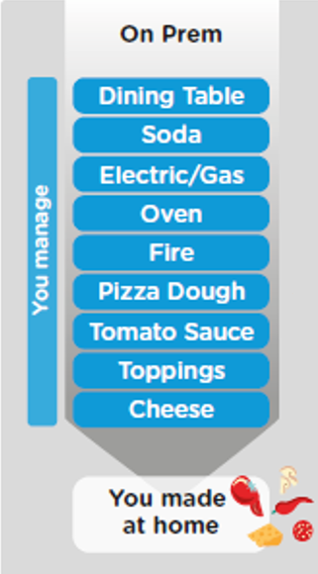
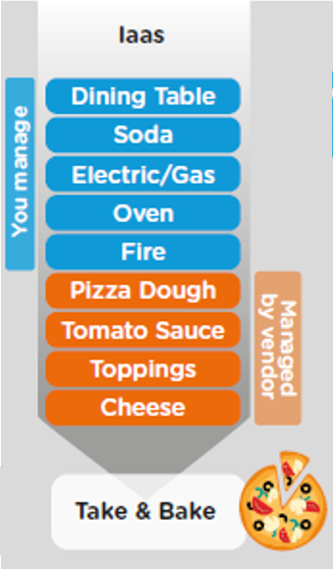
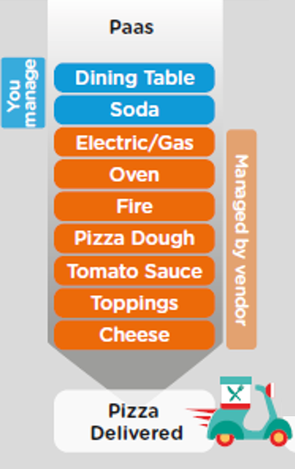
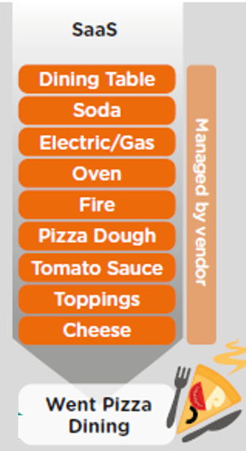
ON-PREMISE V/S CLOUD
www.anubhavtrainings.com

Slide 4
TYPE OF CLOUD OFFERINGS
Application
Application As a Service
Customer Managed
Customer Managed
Customer Managed
SAP Managed
Data
Runtime
Platform as a Service
SAP/Partner Managed
Middleware
Database
OS
Virtualization
Infrastructure as a Service
SAP/Partner Managed
Servers
Storage
Networking
www.anubhavtrainings.com

Slide 5




WHAT IS SAP CLOUD FOUNDRY?
Application
Application
Data
Data
Runtime
Platform as a Service
Managed by SAP implementing open source CF
Middleware
Fully ready landscape with reusable services
Scalability
Elasticity
Low TCO
Database
OS
Managed by Infrastructure
providers
Data Centers
Service Portfolio
Virtualization
Infrastructure as a Service
Servers
Storage
Networking
www.anubhavtrainings.com

Slide 6
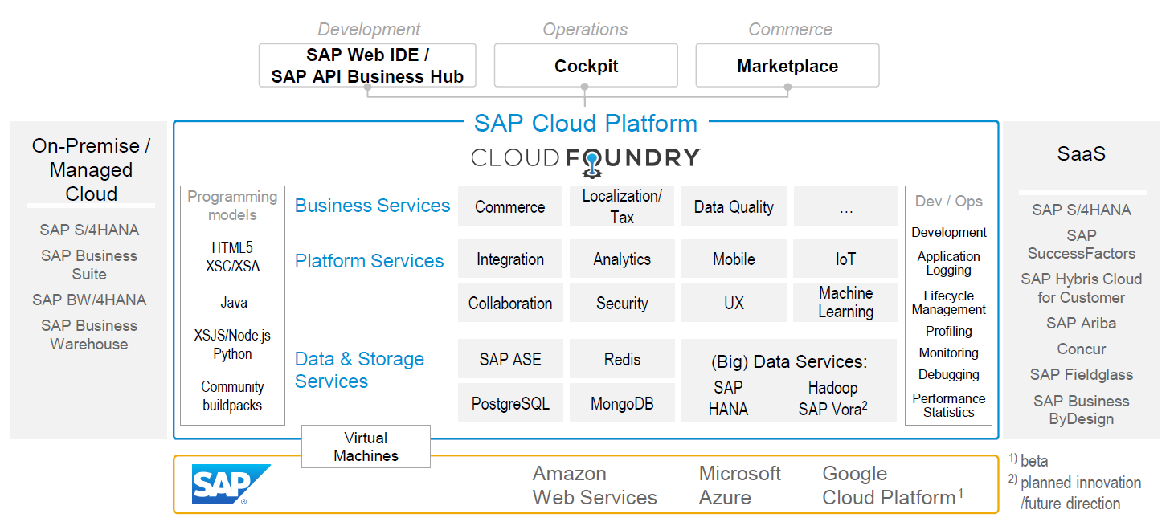
SAP CLOUD FOUNDRY ARCHITECTURE
SAP Business Application Studio
www.anubhavtrainings.com

Slide 7





Why CF (1)
1
Support full development lifecycle
Build Application & Services
Development
Continuous Delivery (CD) = Code ➔ Push ➔ Test ➔ Build
Continuous Integration (CI) = Dev ➔ Quality ➔ Production
Up and Down
Deployment
Testing
Monitor and Upgrade
www.anubhavtrainings.com

Slide 8

Why CF (2)
2
Self healing container management system
Cell
Garden = execution
Containers
A
www.anubhavtrainings.com

Slide 9
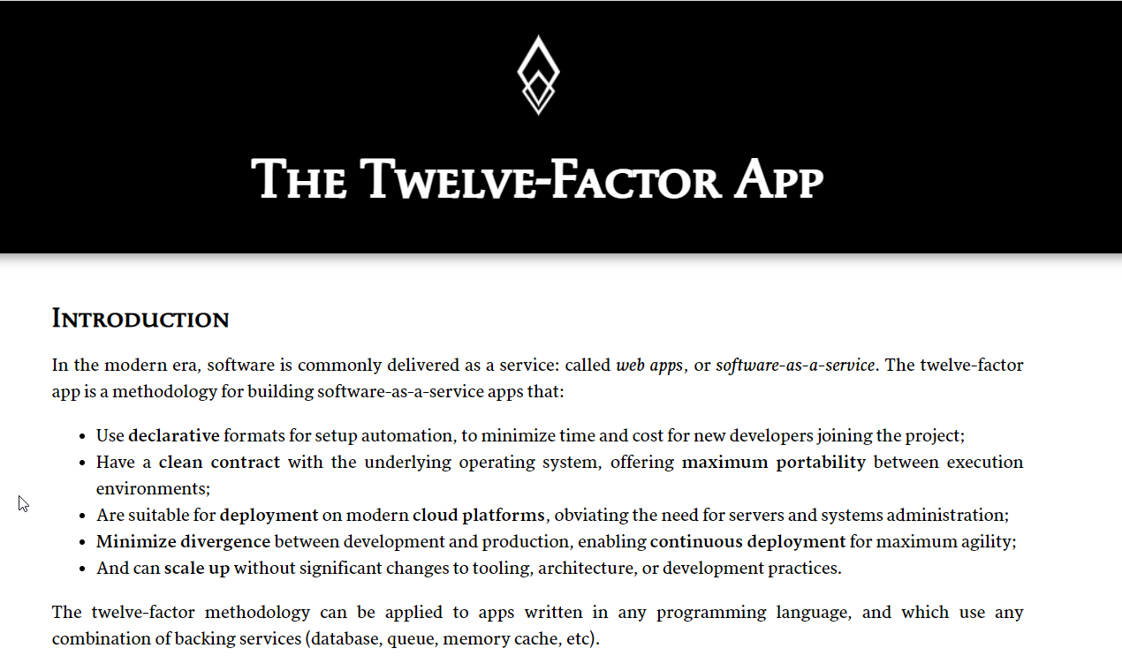

Why CF (3)
3
Support 12 Factor App
It is a strategy to build software-as-a-service
https://12factor.net/
A
www.anubhavtrainings.com

Slide 10
History of CF
License: Apache 2.0
Build in Ruby, Java and Go
Open Governance Foundation
2009-2011
2012
2013
2014
2015
2019
2021
VMWare
BOSH
Open Source Tools
Seven platinum members and two gold members
40+ Members
65+ Members
Jan 2021
Pivotal Cloud foundry closes free trials
Pivotal
EMC
VMWare
General Electric
www.anubhavtrainings.com

Slide 11
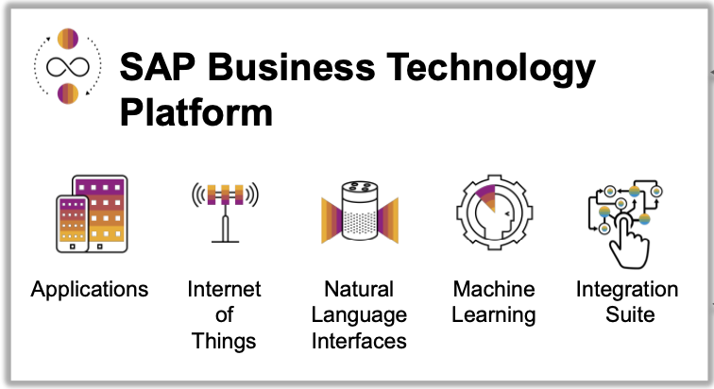
What is SAP BTP ?
SAP Business Technology Platform (SAP BTP) is the platform that powers you to become an intelligent enterprise through integration, extension, and data-to-value from all SAP and third-party application and data assets while ensuring your long-term success through agility, value-creation, and continual innovation.
BTP is an digital platform as a service to allow companies to build/integrate/extend existing solutions

Slide 12
SAP BTP Learning Track
1
Build New Solutions
1
Develop → Deploy → Deliver
2
2
Integrate
Integrate your existing Solutions
3
Extend
4
Extend your existing solutions by consuming data using API
3
4
Adapt new trends
Get to most latest technologies

Slide 13
Setup - Customer View
Backing Services
Global Account
(Representation of customer for billing purpose)
Sub Account
(per region)
Specialized service offerings
Represents LoB
Space quotas
1 *
1 *
Space
1
*
Apps
www.anubhavtrainings.com

Slide 14
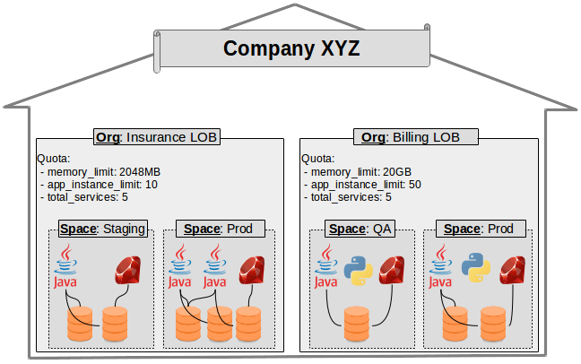
Customer View
www.anubhavtrainings.com

Slide 15
Developer On-boarding
List of all the services which your co. is opting for, the subscription bills will be based on global account.
Global Account
Pricing point of view an a/c which sap will manage
01
02
Don’t forget to add members to your sub accounts according their nature of work.
Used for data center, services offered in a infrastructure, your team members are assigned inside sub account based on their work in co.
We need to create service plan to the sub account, to distribute the overall services offered at global account level.
Sub account
Service offerings based on regions
Space
Create to organize our development e.g. dev, qlt, prod
03
Out of all services available at sub account level, we can further distribute resources to the spaces using quota plan
https://www.sap.com/india/products/business-technology-platform.html

Slide 16
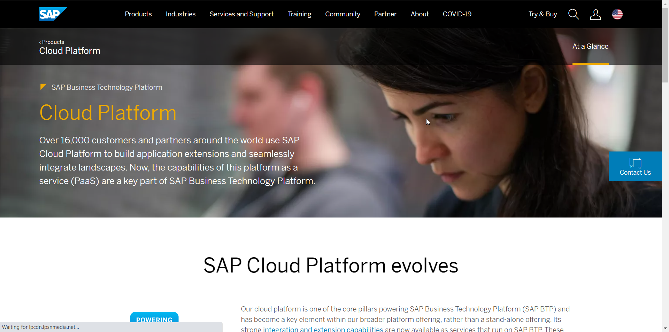
Setup Your FREE Account
https://account.hanatrial.ondemand.com/trial/#/home/trial
www.anubhavtrainings.com

Slide 17

End of Day 22
Trainer: Anubhav Oberoy

Slide 18

Trainer: Anubhav Oberoy

Slide 19
THANK YOU
If you cannot do
great things, do small things in a great way.
Anubhav Oberoy
https://www.anubhavtrainings.com

Slide 20


We’re committed to empower you to be
Most Desirable Resource
through powerful training solutions.
We build the workforce of the future.
250+
Corporate Clients
30,000+
Learners Trained
25000+
Learners Placed
FREE WEBINARS
Sign up for free webinars with industry experts every fortnight!
Enroll Now!
Contact us today!
https://anubhavtrainings.com/

Slide 21




More from AnubhavTrainings.com

